Slide 1
Remember to…
Sign in to the UoW App
Wipe your desk space before and after use
Log into eduroam when on campus
If you have symptoms, stay at home and report them

Slide 2

Algorithmic Design
Week 6 Hybrid Session 1

Slide 3
This Week
MID SEMESTER FEEDBACK
Algorithms
Flowcharts

Slide 4
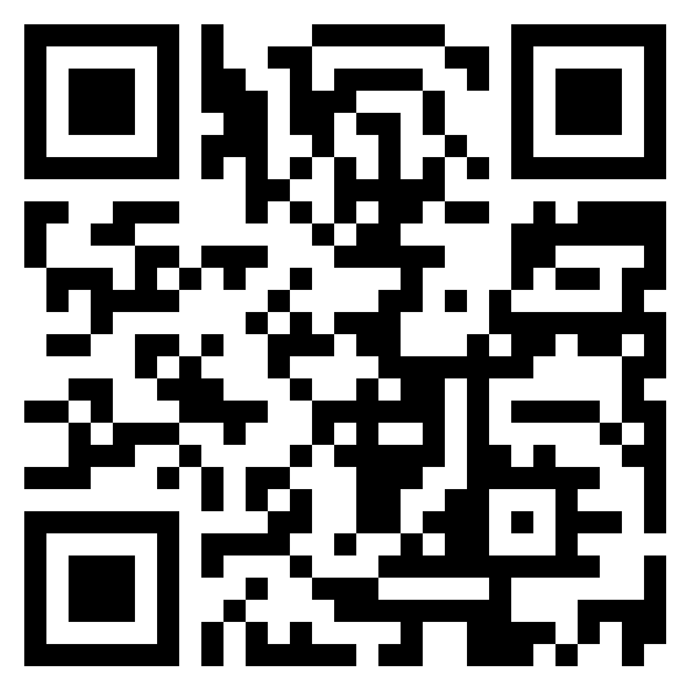
Before we start…
We want your feedback:
What is going well?
What is not going well?
Do you have any suggestions?

Slide 5
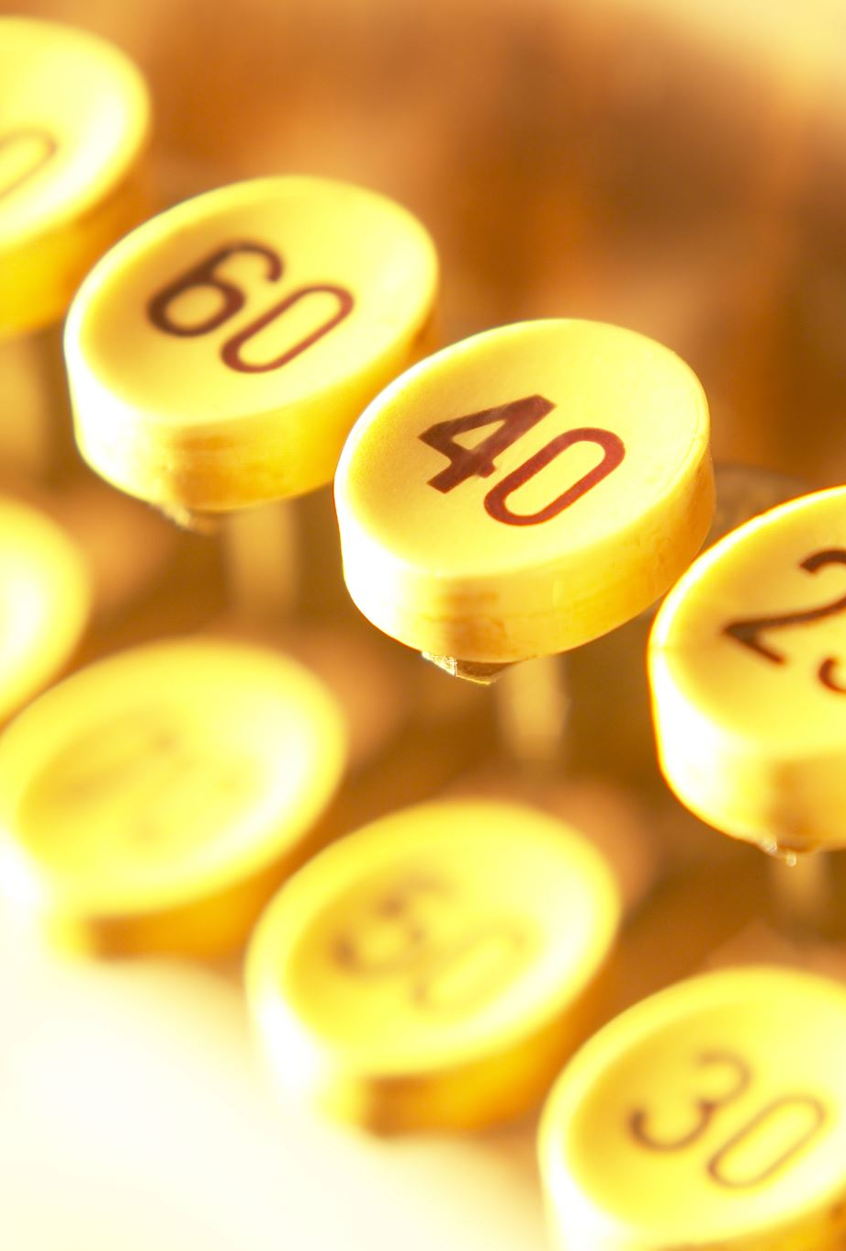
Your Task in 6.2
Design an algorithm (using pseudocode) for the following scenario:
You have been asked to write a program which will take a number input from the user and then:
Prints the first terms of the Fibonacci sequence up to and including the term number entered by the user
Prints the sum of the even numbers in that sequence.
For example, if the user enters 10, the system will output the following:
The first 10 Fibonacci numbers are: 1 1 2 3 5 8 13 21 34 55
The sum of the even numbers in the first 10 Fibonacci numbers is: 44

Slide 6
6.6: What is a Flowchart?
A flowchart is a diagram that depicts a process, system or computer algorithm (Lucid Chart, 2020)
A method for displaying your algorithm
Visual representation
Specific shapes for different elements of the operation

Slide 7
6.7: Flowchart Symbols
What are each of these symbols?
Complete the crib sheet

Slide 8

6.8: Designing Flowcharts
Key Question: If you were to do this on paper (ignoring the computer and the need to code) what would you do?
What steps are needed?
Are any decisions needed?
What are the inputs?
What are the outputs?
What symbols do you need?

Slide 9
What steps are needed?
Get first number
Ask for number
User enters number
Validate the entry is a number
Assign to variable
Get second number
Ask for number
User enters number
Validate the entry is a number
Assign to variable
Calculate sum
Add two numbers together
Assign to variable
Print Sum

Slide 10
Are any decisions needed?
Get first number
Ask for number
User enters number
Validate the entry is a number
Assign to variable
Get second number
Ask for number
User enters number
Validate the entry is a number
Assign to variable
Calculate sum
Add two numbers together
Assign to variable
Print Sum

Slide 11
Are any decisions needed?
Get first number
Ask for number
User enters number
Validate the entry is a number (Decision)
Assign to variable
Get second number
Ask for number
User enters number
Validate the entry is a number (Decision)
Assign to variable
Calculate sum
Add two numbers together
Assign to variable
Print Sum

Slide 12
What are the inputs?
Get first number
Ask for number
User enters number
Validate the entry is a number (Decision)
Assign to variable
Get second number
Ask for number
User enters number
Validate the entry is a number (Decision)
Assign to variable
Calculate sum
Add two numbers together
Assign to variable
Print Sum

Slide 13
What are the inputs?
Get first number
Ask for number
User enters number (Input)
Validate the entry is a number (Decision)
Assign to variable
Get second number
Ask for number
User enters number (Input)
Validate the entry is a number (Decision)
Assign to variable
Calculate sum
Add two numbers together
Assign to variable
Print Sum

Slide 14
What are the outputs?
Get first number
Ask for number
User enters number (Input)
Validate the entry is a number (Decision)
Assign to variable
Get second number
Ask for number
User enters number (Input)
Validate the entry is a number (Decision)
Assign to variable
Calculate sum
Add two numbers together
Assign to variable
Print Sum

Slide 15
What are the outputs?
Get first number
Ask for number
User enters number (Input)
Validate the entry is a number (Decision)
Assign to variable
Get second number
Ask for number
User enters number (Input)
Validate the entry is a number (Decision)
Assign to variable
Calculate sum
Add two numbers together
Assign to variable
Print Sum (Output)

Slide 16
What symbols do you need?
Get first number
Ask for number
User enters number (Input)
Validate the entry is a number (Decision)
Assign to variable
Get second number
Ask for number
User enters number (Input)
Validate the entry is a number (Decision)
Assign to variable
Calculate sum
Add two numbers together
Assign to variable
Print Sum (Output)

Slide 17
What symbols do you need?
Get first number
Ask for number (Process)
User enters number (Input)
Validate the entry is a number (Decision)
Assign to variable (Process)
Get second number
Ask for number (Process)
User enters number (Input)
Validate the entry is a number (Decision)
Assign to variable (Process)
Calculate sum
Add two numbers together (Process)
Assign to variable (Process)
Print Sum (Output)

Slide 18
A
B
Start
Ask the user to enter number
Ask the user to enter number
Add together the numbers for input1 and input2
Print Invalid Entry
Print Invalid Entry
User enters number
User enters number
Assign the sum to a sum variable
Number?
No
Number?
No
Yes
Yes
Print the sum variable
Assign number input1 variable
Assign number input2 variable
A
B
Stop

Slide 19
Get Number Pre-defined Process
B
Start
Start
Add together the numbers for input1 and input2
Ask the user to enter number
Get Number (input1)
Print Invalid Entry
User enters number
Assign the sum to a sum variable
Number?
No
Get Number
(input2)
Flowchart becomes
Print the sum variable
Yes
Assign to variable
B
Stop
Stop

Slide 20
Calculate Sum Pre-defined Process
B
Start
Start
Get Number (input1)
Calculate Sum
Add together the numbers for input1 and input2
Assign the sum to a sum variable
Get Number
(input2)
Flowchart becomes
Print the sum variable
Stop
B
Stop

Slide 21

Your Turn
Using your algorithm from 6.2, design the flowchart for the Fibonacci sequence program.
Make sure you ask yourself the questions we covered earlier

